Slide 1
Powerhouse Field Trip
Follow up Lessons
Twin Rivers Unified School District

Slide 2
Electricity and Magnetism

Slide 3
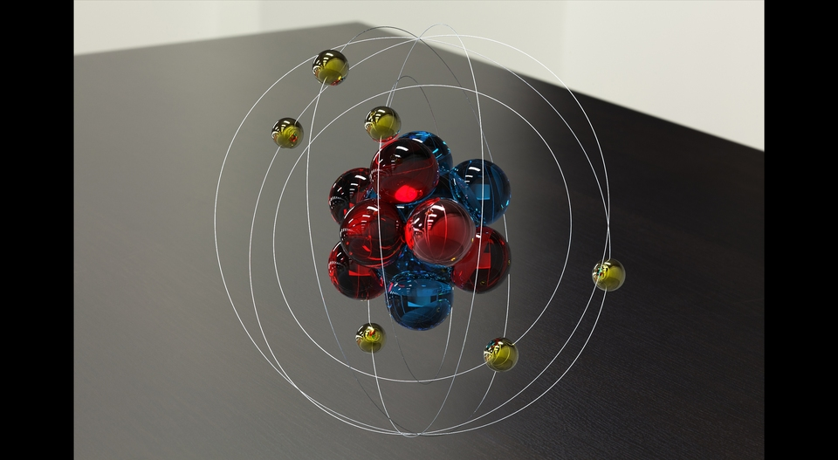
IN ATOMS, THERE ARE ELECTRONS.
BOTH OF THESE ARE MODELS. THE DRAWING SHOWS THE CENTER OF THE ATOM AND THE ELECTRONS ROTATING AROUND.
THE 3-D MODEL HAS THE ELECTRONS MOVING ABOUT ON WIRES. REAL ELECTRONS ORBIT AROUND THE NUCLEUS.
AN ELECTRON ON THE OUTER ORBIT OR SHELL CAN JUMP FROM ONE ATOM TO THE OTHER. SEE THE ARROW.

Slide 4
Where does electricity come from?
ELECTRICAL CURRENT IS CREATED WHEN ELECTRONS TRAVEL FROM ONE ATOM TO ANOTHER.
THINK OF A TUBE FULL OF BALLS. IF YOU PUSHED A NEW BALL IN ONE END, ANOTHER BALL WOULD FALL OUT THE OTHER. NOT THE SAME BALL BUT THE FORCE OF THE BALL GOING IN WOULD TRAVEL ALONG THE TUBE AND PUSH OUT THE OTHER.
SO ELECTRONS JUMP ALONG FROM ATOM TO ATOM.

Slide 5
ELECTRICAL CIRCUITS
THIS FLOW OF ELECTRONS IS CALLED ELECTRICITY. TO MAKE THE LIGHT SHINE AN ELECTRICAL CIRCUIT HAS TO BE CREATED.

Slide 6
ELECTRO-MAGNETS
IN THE MS. FRIZZLE STORY, THEY TALK ABOUT MAKING ELECTRICITY WITH MAGNETS.
WHEN THE MAGNET IS MOVED BACK AND FORTH, THE ELECTRONS IN THE COPPER WIRE BEGIN TO JUMP FROM ONE ATOM TO THE NEXT—CREATING ELECTRICITY. If THE WIRES ARE CONNECTED TO MAKE A CIRCUIT—THERE IS ELECTRICITY!!

Slide 7
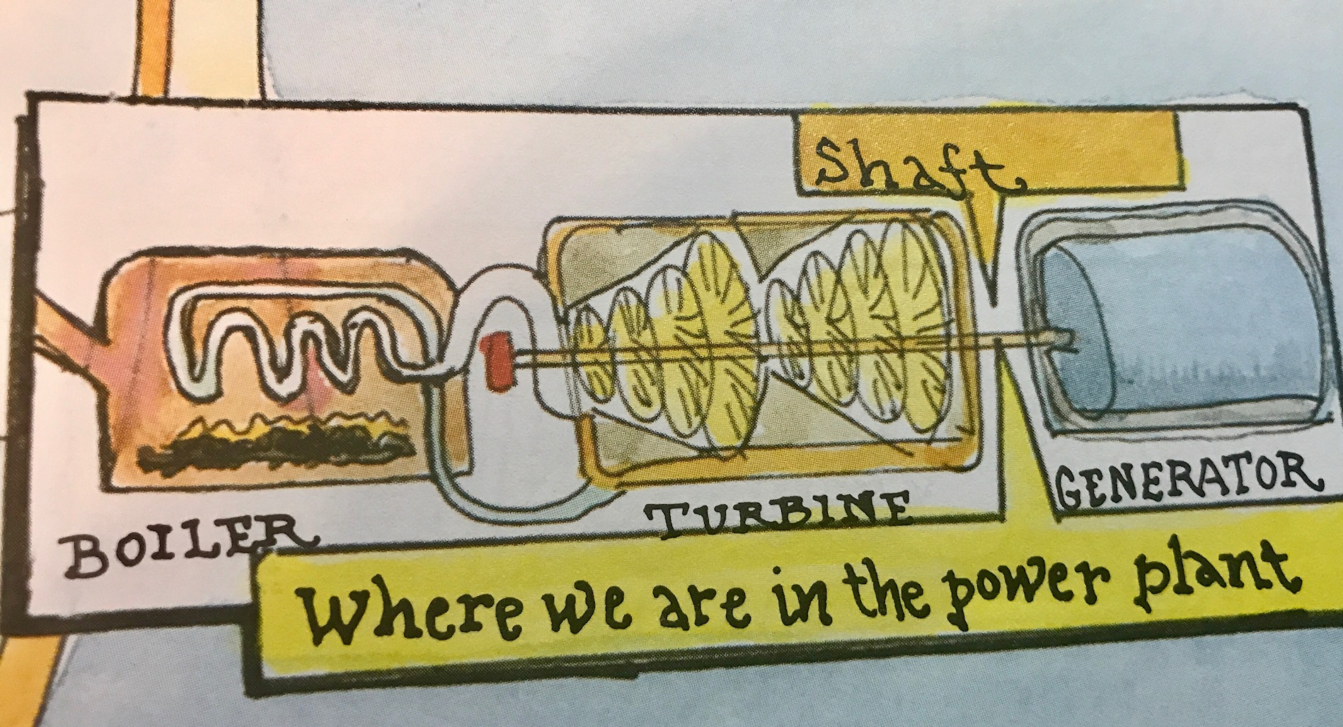
ELECTRICITY IS GENERATED AT LARGE POWER PLANTS THAT USE HUGE ELECTRO-MAGNETS.
Almost all power plants use magnets. Without magnetism, we could not make large amounts of electricity.

Slide 8
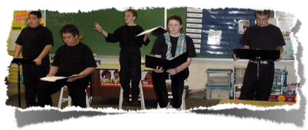
Introduction to Readers Theater
Readers Theater is reading a story or book like it is a play.
There are actors who read for the characters. Narrators read the narration for a specific character or group of characters.
Readers theater can be performed anywhere.
No props are needed, it is up to actors to paint the picture in the audience’s imagination.

Slide 9
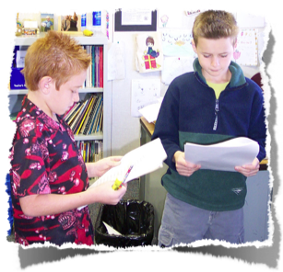
Steps to performing RT
Read through the script.
Highlight the character you are assigned.
Practice several times with your group.
Think about the character and what is happening. How can you use your voice and your face to communicate emotions and actions?

Slide 10
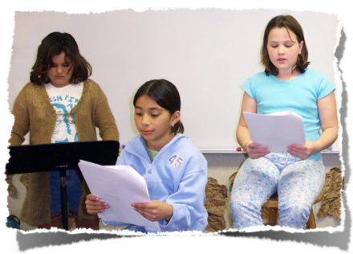
Things to remember
Read loudly but don’t yell. This is called projection.
Keep your eyes on the script so you are ready to read your part as the character would say it.
Practice really does make perfect.

